Slide 1
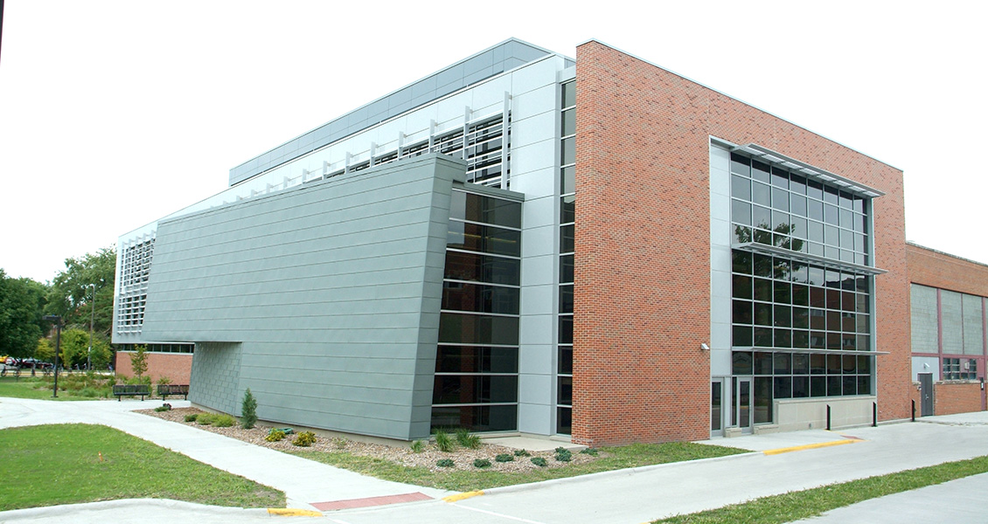
Department of Electrical and Computer Engineering
Have no fear! The room you’re looking for is right here.

Slide 2
Exploring Synergies
Aligning Research Interests for Potential Funding Opportunities
Presented by:
Shahab Afshar
PhD Student, Computer Engineering
Advisor:
Professor Ashfaq Khokhar
Chair, Department of Electrical and Computer Engineering

